Slide 1
Capstone project
PRESENTED BY
NITHYA.P
Arunai engineering college

Slide 2
PROJECT TITLE
COLLEGE CHATBOT

Slide 3


AGENDA
PROJECT OVERVIEW
WHO ARE THE END USERS
YOUR SOLUTION AND ITS VALUE PROPOSITION
PROBLEM STATEMENT
THE WOW IN YOUR SOLUTION
MODELLING
RESULTS
3/21/2024 Annual Review

Slide 4

PROBLEM STATEMENT
"The problem statement for a college chatbot could be framed as follows:"
""Develop a conversational AI chatbot for a college or university to assist students, faculty, and staff with various tasks and inquiries. The chatbot should be capable of providing information about courses, campus facilities, events, admission procedures, academic deadlines, campus resources, and other relevant topics. Additionally, the chatbot should be able to handle frequently asked questions, offer personalized assistance, and potentially integrate with existing systems such as student databases and scheduling platforms. The goal is to improve accessibility, efficiency, and user experience for individuals interacting with the college or university.""
"Does this align with what you had in mind, or would you like to refine the problem statement further?"

Slide 5

PROJECT OVERVIEW
“Project Title: College Chatbot Development Project Overview: The project aims to develop a conversational AI chatbot tailored for a college or university environment. The chatbot will serve as a virtual assistant to help students, faculty, and staff with various tasks and inquiries related to academic, administrative, and campus life matters. Key Objectives:”
"Design and Develop Conversational Interface: Design an intuitive and user-friendly conversational interface for the chatbot, allowing users to interact naturally using text or voice commands.
Knowledge Base Creation: Create a comprehensive knowledge base covering various topics such as courses, programs, campus facilities, admission procedures, academic calendars, events, and student services.
Natural Language Understanding (NLU): Implement natural language processing (NLP) techniques to enable the chatbot to understand user queries accurately and extract relevant information."

Slide 6
"Personalization and Context Awareness: Incorporate algorithms to personalize responses based on user preferences, history, and context of the conversation to enhance user experience.
Integration with Backend Systems: Integrate the chatbot with backend systems such as student databases, course management systems, event calendars, and other relevant databases to fetch real-time information.
Multi-Platform Deployment: Deploy the chatbot across multiple platforms including web, mobile, and messaging apps to maximize accessibility for users."
"Testing and Evaluation: Conduct thorough testing to ensure the chatbot functions reliably, handles various user inputs gracefully, and provides accurate responses. Evaluate user feedback to iteratively improve the chatbot's performance.
Documentation and Training: Provide comprehensive documentation for developers and end-users on how to interact with the chatbot effectively. Offer training sessions for administrators responsible for maintaining and updating the chatbot."
"Deliverables:
Functional College Chatbot: A fully functional chatbot capable of assisting users with a wide range of inquiries related to college or university life.
Documentation: Technical documentation detailing the architecture, design decisions, and implementation details of the chatbot. User documentation providing guidelines on interacting with the chatbot.

Slide 7
Training Materials: Training materials for administrators and end-users to facilitate the adoption and usage of the chatbot.
Evaluation Report: A report summarizing the testing process, user feedback, and recommendations for further enhancements.
"Timeline:
The project will be divided into distinct phases with specific milestones and deadlines. The timeline will depend on factors such as the complexity of the chatbot, availability of resources, and development methodology.
Budget:
Allocate resources for software development tools, cloud services (if applicable), personnel, and any other expenses associated with the project.By following this project overview, you can effectively plan and execute the development of a college chatbot to meet the needs of your institution and its stakeholders."

Slide 8

WHO ARE THE END USERS?
"The end users of the college chatbot could include:
Students: They may use the chatbot to inquire about course offerings, academic deadlines, campus events, student services, housing options, extracurricular activities, and general information about the college or university.
Faculty and Staff: Faculty members and administrative staff might utilize the chatbot to access information about class schedules, campus facilities, administrative procedures, faculty resources, and professional development opportunities."
"Prospective Students: Prospective students may interact with the chatbot to gather information about admission requirements, application procedures, academic programs, campus tours, financial aid, and other aspects of the college or university.
Parents and Guardians: Parents or guardians of students may use the chatbot to obtain information about tuition fees, campus safety measures, academic support services, and other relevant topics to support their children's education.
Alumni: Alumni might engage with the chatbot to stay informed about alumni events, fundraising initiatives, career services, and opportunities to stay connected with the college or university community."

Slide 9
"Visitors and Guests: Visitors to the campus, including prospective donors, community members, and guests attending events, may use the chatbot to access directions, parking information, event schedules, and other relevant details.
By catering to the needs of these diverse user groups, the college chatbot can serve as a valuable resource to enhance communication, accessibility, and efficiency within the college or university ecosystem."

Slide 10

YOUR SOLUTION AND ITS VALUE PROPOSITION
"Based on the problem statement and end-user considerations, here's a refined solution proposition for the college chatbot project:
Solution Proposition: College Chatbot for Enhanced Campus Experience
Overview:The College Chatbot is an intelligent virtual assistant designed to streamline communication, provide quick access to information, and enhance the overall campus experience for students, faculty, staff, and visitors. Leveraging cutting-edge natural language processing (NLP) technology, the chatbot offers personalized assistance and access to a wide range of campus-related services and resources."

Slide 11
"Key Features:
Personalized Assistance: The chatbot utilizes machine learning algorithms to understand user preferences, history, and context, delivering tailored responses and recommendations.
Comprehensive Knowledge Base: A robust knowledge base covers topics such as course offerings, academic calendars, campus facilities, administrative procedures, student services, events, and more.
Multi-Platform Accessibility: The chatbot is accessible via web browsers, mobile apps, and popular messaging platforms, ensuring seamless interaction for users across different devices and channels."
"Real-Time Information Retrieval: Integration with backend systems enables the chatbot to fetch real-time data from student databases, course management systems, event calendars, and other relevant sources, ensuring accuracy and timeliness of information.
24/7 Availability: The chatbot operates round the clock, providing instant assistance and support to users regardless of time or location, improving accessibility and user satisfaction.
Natural Language Understanding: Advanced natural language understanding (NLU) capabilities allow the chatbot to comprehend and interpret user queries accurately, even handling complex or ambiguous inputs effectively
"By implementing this solution, the college or university can effectively leverage AI-driven technology to transform communication, streamline operations, and create a more connected and empowered campus community."

Slide 12

THE WOW IN YOUR SOLUTION
"Here are the "wow" factors in the proposed solution for the college chatbot:
Personalized Assistance: The chatbot's ability to provide tailored responses based on user preferences, history, and context adds a personalized touch, making interactions more engaging and relevant for each user.
Real-Time Information Retrieval: Integration with backend systems enables the chatbot to fetch real-time data, ensuring that users always receive accurate and up-to-date information, which enhances trust and reliability."
"24/7 Availability: The chatbot's round-the-clock availability ensures that users can access assistance and support at any time, offering unprecedented convenience and accessibility for students, faculty, staff, and visitors.
Natural Language Understanding: Advanced natural language understanding capabilities empower the chatbot to interpret user queries accurately, even handling complex or ambiguous inputs gracefully, which enhances the user experience and reduces frustration."
3/21/2024 Annual Review

Slide 13
"Multi-Platform Accessibility: The chatbot's availability across various platforms, including web browsers, mobile apps, and messaging platforms, offers seamless interaction for users across different devices and channels, demonstrating a commitment to accessibility and user convenience.
Efficiency and Productivity: By automating routine inquiries and tasks, the chatbot frees up valuable time for users, enabling them to focus on more meaningful activities and responsibilities, thereby increasing overall efficiency and productivity."
"Scalability and Adaptability: Built on scalable and adaptable architecture, the chatbot can evolve and expand its capabilities over time to meet changing user demands and technological advancements, ensuring long-term relevance and value for the institution.
These "wow" factors collectively contribute to a transformative solution that revolutionizes communication, streamlines operations, and creates a more connected and empowered campus community, ultimately positioning the college or university as a leader in leveraging AI-driven technology to enhance the student experience."

Slide 14
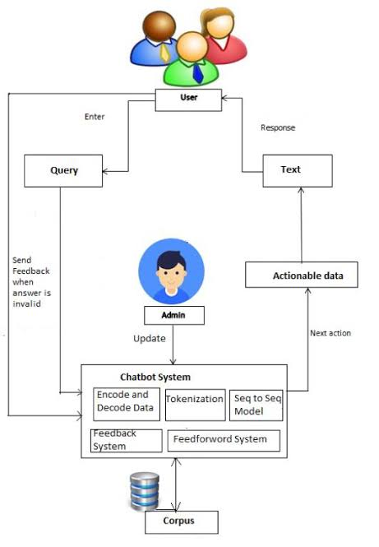
MODELLING

Slide 15
RESULTS
"The specific results of a college chatbot would vary based on its implementation and objectives. Some common results might include:
Improved efficiency: Reduction in response time to student inquiries, enabling faster access to information.
Increased engagement: Higher interaction rates with students seeking information or assistance.
Enhanced user satisfaction: Positive feedback from students regarding the effectiveness and usefulness of the chatbot."
"Reduction in administrative workload: Chatbot handling routine queries, freeing up staff time for more complex tasks.
Data insights: Gathering analytics on student inquiries to identify trends and areas for improvement in services or resources.
Cost savings: Potentially reducing the need for additional staff or resources to handle inquiries manually.Improved accessibility: Providing a 24/7 resource for students to access information regardless of time or location."
"These results can help the college or university improve its services, streamline operations, and enhance the overall student experience."

Slide 16
THANk YOU

